Slide 1
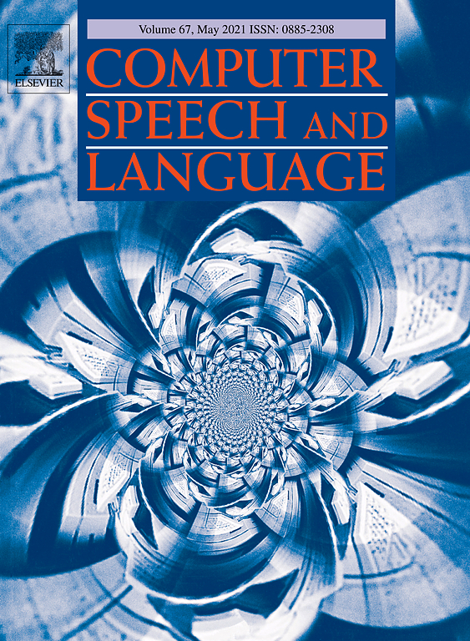
Gated dynamic convolutions with deep layer fusion for abstractive document summarization
Sharer：段志丽

Slide 2
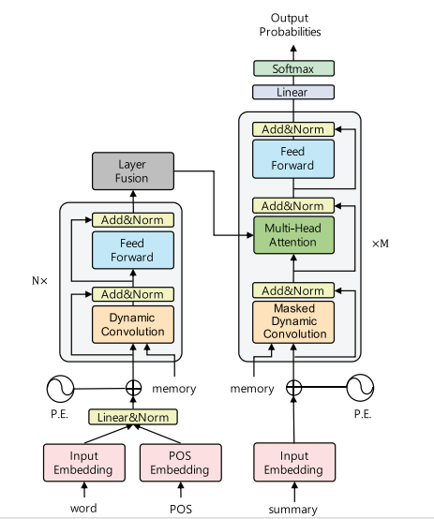
The main contribution of the article
In this paper, focus on the improvement of the model. There are three areas for improvement：
1. POS augmentation
2. Layer aggregation
3. Gating mechanism

Slide 3
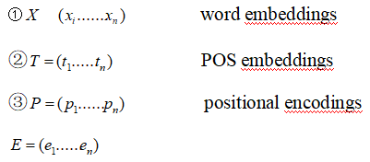
POS augmentation
We reason that explicit POS tags would allow the kernel function to recognize categories of words with similar grammatical properties that would be informative in determining the desired focus in the given context window.
At generation time .. another challenging task and requires a large amount of computation.

Slide 4
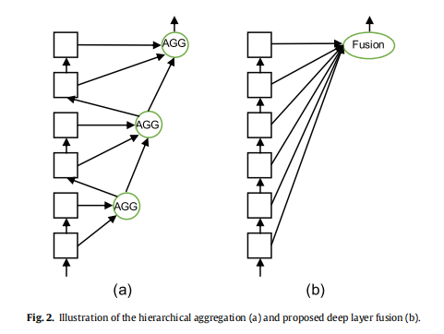
Deep layer fusion
1 most existing methods only use the top layer of the encoder to generate output sequences, discarding any useful features located in the lower layers of the encoder. 2 a huge amount of additional parameters to fuse the encoder layers, leading to slower training and decoding.

Slide 5
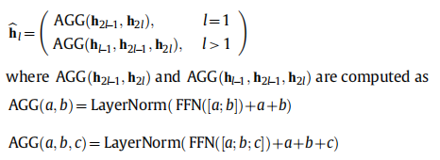
Deep layer fusion

Slide 6
Deep layer fusion

Slide 7
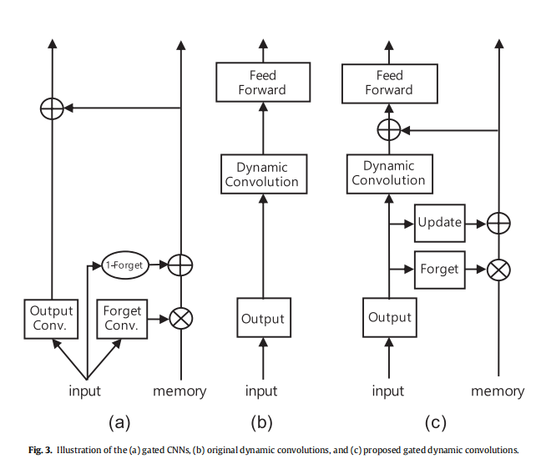
Gating mechanism
propose a gating mechanism that is capable of retaining and reusing representations from previous layers, allowing for the construction of
rich intermediate layer representations.

Slide 8
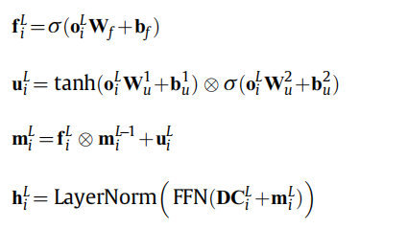
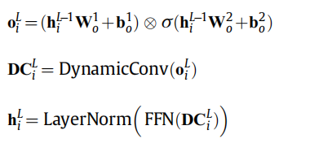
Gating mechanism

Slide 9
Gating mechanism

Slide 10
To summarize,
0.we use dynamic convolutions as a base architecture to handle the long inputs of the document summarization task.
1.We inject POS information into the lowest dynamic convolution layer so that the model may more easily extract features from salient keywords in the lower layers.
2.We also propose a fusion layer that assembles useful features from the lower layers.
3. we apply a gating mechanism that is capable of retaining and reusing representations from previous layers, allowing for the construction of rich intermediate layer representations.

Slide 11
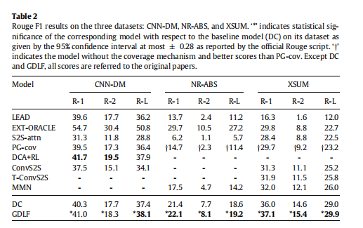
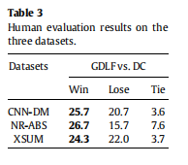
Experiment
GDLF improvesthe baseline model via the addition of a gating mechanism, layer fusion, and POS augmentation, and shows a statistically significant improvement over DC on all ROUGE metrics on the three datasets.

Slide 12
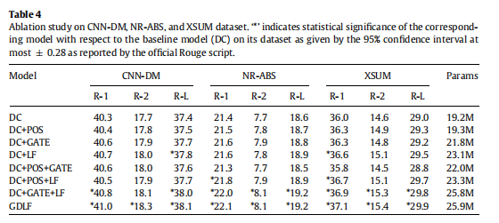
Experiment

Slide 13
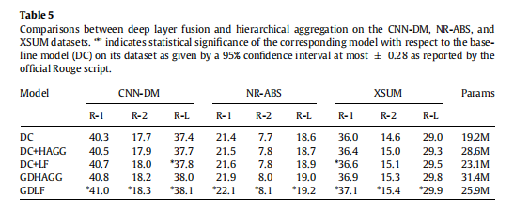
Experiment

Slide 14
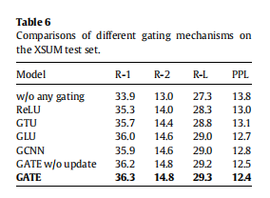
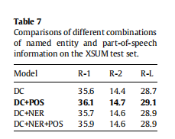
Experiment

Slide 15
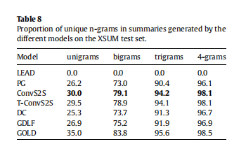
Experiment
We compared the extent of our model’s abstractiveness of writing summaries with that of baseline models and the gold-stan_x0002_dard summary. Table 8 shows the ratio of unique n-grams that are not present in the document for LEAD, PG, ConvS2S, T_x0002_ConvS2S, DC, GDLF, and GOLD (gold-standard summary). As can be seen, the ConvS2S models show the highest proportion of unique n-grams among the neural models, but is still worse than GOLD.

Slide 16
Thanks

